Slide 1
Directions
You’ll need your habits book and two sheets of notebook paper
On sheet one, take notes over what you learn
On sheet two, write the answers to the questions that you’ll turn in for a grade

Slide 2
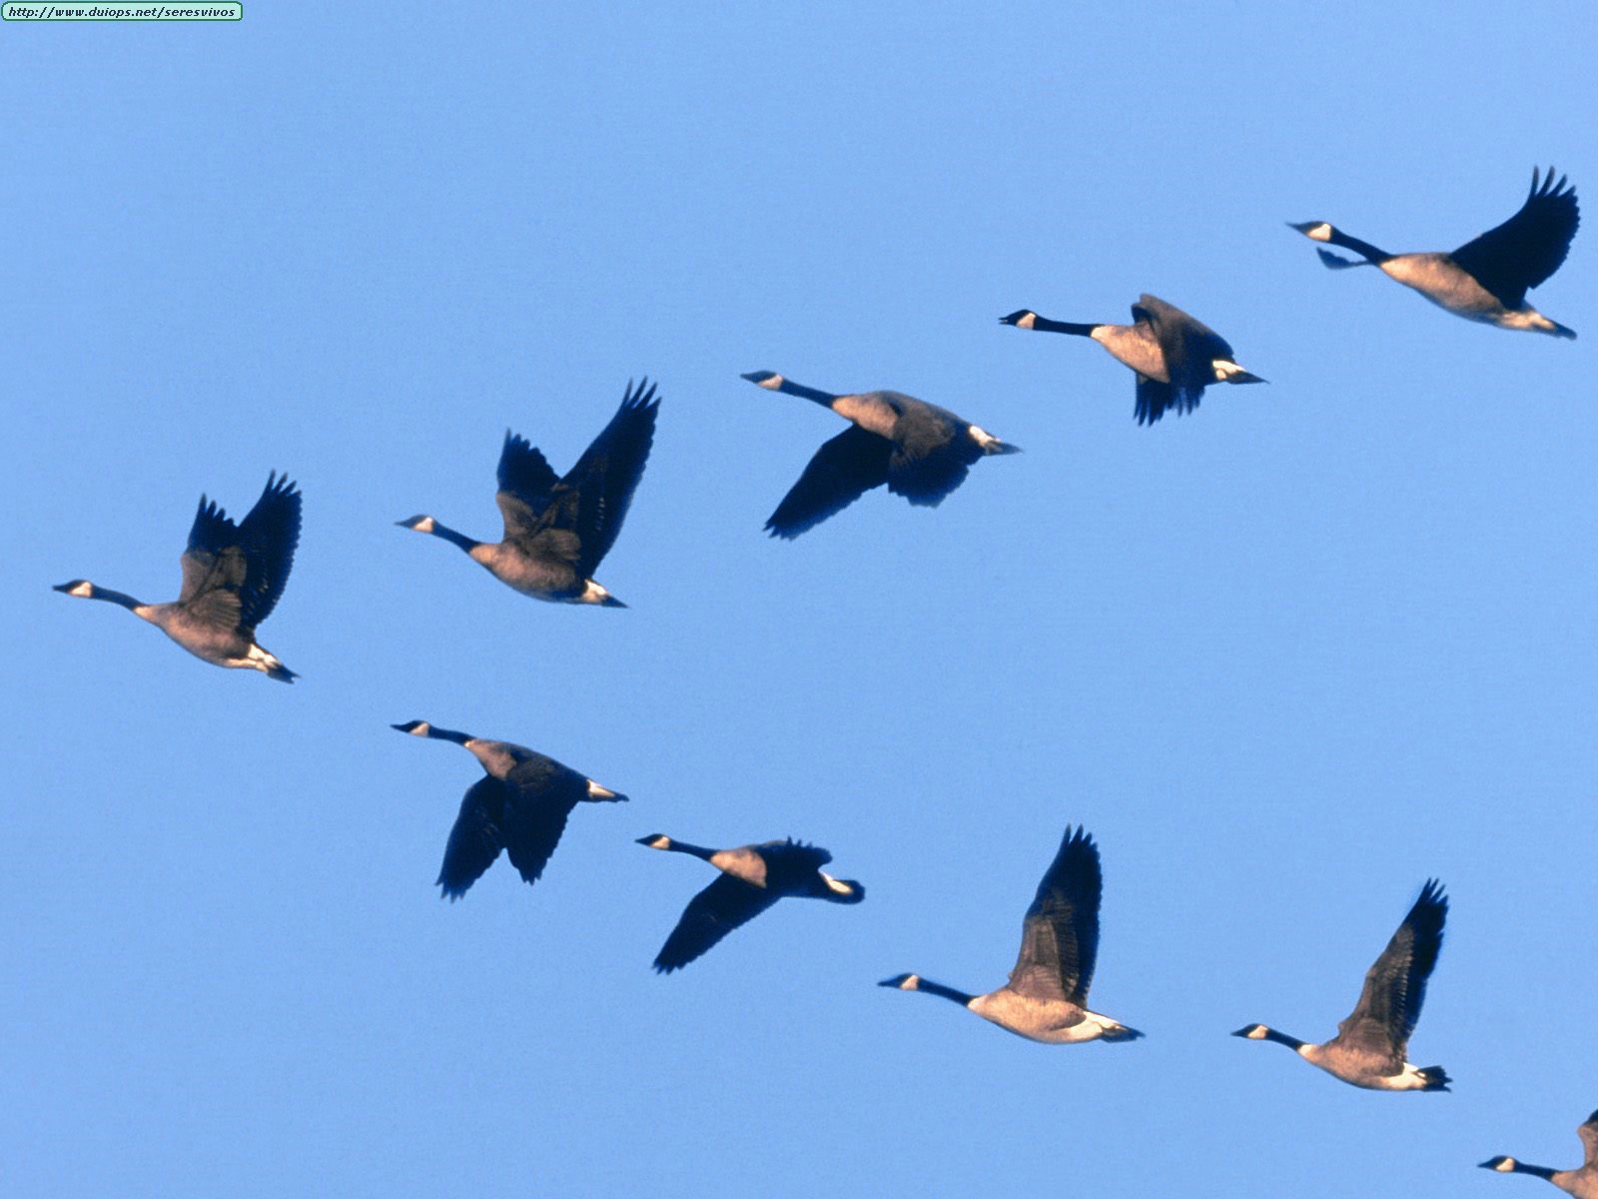
Habit 6
Synergy
The “High” Way

Slide 3
Alone we can do so little; together we can do so much.
Helen Keller

Slide 4
Geese – Synergy Is there a correlation to people?
Work together to stay stronger and go further
Leader
Leaders take turns to rest and give other opportunities
Followers encourage
When one doesn’t follow the plan….feels resistance and rejoins the group
Help and protect those who are sick or wounded, stick together until the end and then join a new formation or create their own to catch up with the group

Slide 5
What is synergy?
The interaction of elements that when combined produce a total effect that is greater than the sum of the individual elements, contributions, etc.; synergism.

Slide 6
What is synergy?
Synergy is achieved when two or more people work together to create a better solution than either could alone.

Slide 7
It is not your way or my way, but a better way; a “higher” way.

Slide 8
Synergy
Is
Celebrating differences
Teamwork
Open-mindedness
Finding new and better ways
Win-Win
Is Not
Tolerating differences
Working independently
Thinking you’re always right
Comprise

Slide 9
Talk and Write #1
(Write answers on NB paper #2)
Discuss what you have just learned with the person next you first…
Q1: Do you think you are good at having synergy? Why or why not?

Slide 10
Shunner’s Profile
Shunner’s Profile
Afraid, can be scared to death
Enjoy ridiculing those who are different, believe they are saving the world
Tolerator’s Profile
believe that everyone has the right to be different
Don’t shun, but don’t embrace diversity “You keep to yourself and I’ll keep to myself”
Celebrator’s Profile
Value differences
See them as an advantage, not a weakness.

Slide 11
One type isn’t better than the other, only different.

Slide 12
Look at pgs 182-187

Slide 13
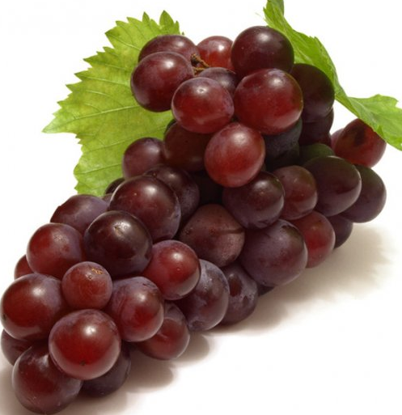
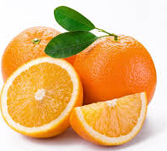
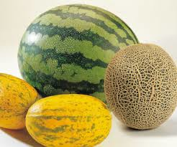
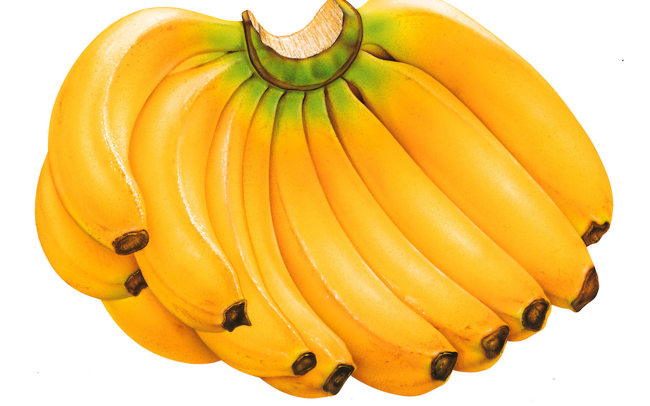
Q2: Discuss then write: If you were a fruit, what type of fruit would you be?

Slide 14
What does this mean?

Slide 15
Partners
Discuss with a partner
Which fruit do you most likely mix with the best?
Which fruit do you most likely mix with the worst?

Slide 16
Now Write, choose TWO Q3 and Q4:
Discuss one interesting thing from this habit.
Discuss one thing that bothered you.
Discuss one thing you learned?
Discuss one thing you are going to change in your own life based on this information.

Slide 17
Road blocks and Finding the “High” way.
Beginning on page 189, read the remainder of the chapter

Slide 18
Roadblocks- Read about it in your book (take 5 mins)
Ignorance
Cliques
Prejudice

Slide 19
They died from the cold within?
What does this mean?

Slide 20
Q5: Discuss then write. Explain the higher way and how you can use this methodology?

Slide 21
Teamwork and Synergy
Plodders
Followers
Innovators
Harmonizers
Show-offs

Slide 22
Habit 7
Sharpen the saw

Slide 23
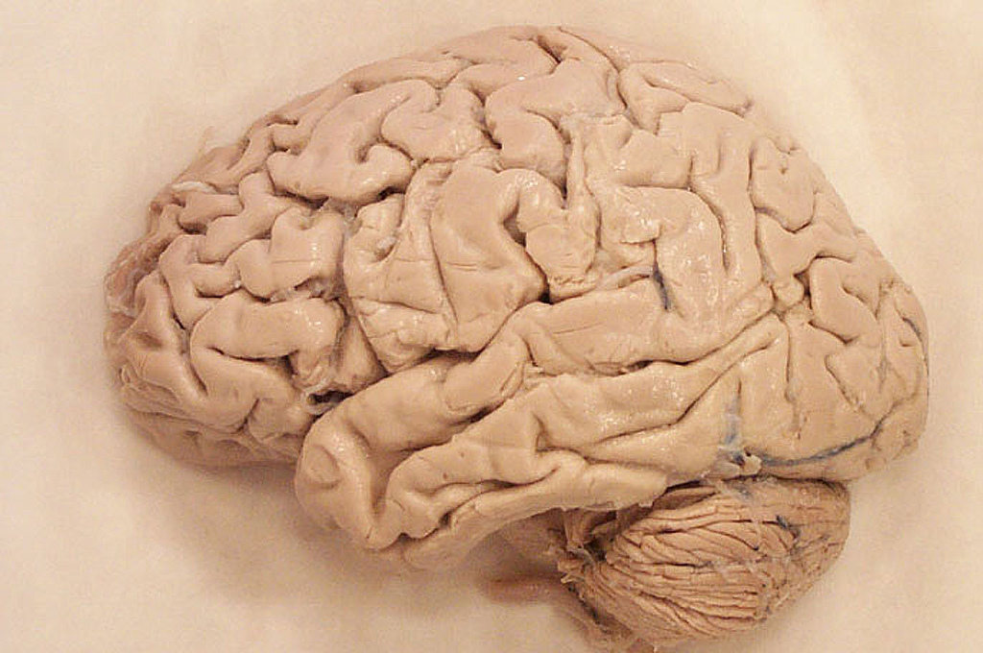
Body, Brain, Heart and Soul
Read about your element
Develop a visual
Create a definition
Provide examples
Share a fun fact for this category
Present to the class

Slide 24
Discuss, then write, choose 2, Q6 and Q7
How do you feel about this 7 Habits journey?
What have you learned?
How have you or will you change?
How is it important?
Explain one thing, that you didn’t already know, that you learned from each of the four elements of Habit 7.

